Slide 1
ALGORITHMIC STATE MACHINES
CME 2003
Digital Logic
Şerife SUNGUN

Slide 2
Introduction to Sequential Logic
Output depends on current as well as past inputs
  Depends on the history
  Have “memory” property
Sequential circuit consists of
    Combinational circuit
    Feedback circuit
  Past input is encoded into a set of state variables
    Uses feedback (to feed the state variables)
      Simple feedback
      Uses flip flops
DEU CSE
Şerife SUNGUN

Slide 3
Introduction…
Main components of a typical synchronous sequential circuit
(synchronous = uses a clock to keep circuits in lock step)
INPUT
COMBINATIONAL
LOGIC
OUTPUT
PRESENT STATE
S(t)
NEXT STATE
S(t+1)
STATE-HOLDING ELEMENTS
(i.e. FLIP-FLOPS)
CLOCK
DEU CSE
Şerife SUNGUN

Slide 4
State-Holding Memory Elements
Latch versus Flip Flop
  Latches are level-sensitive: whenever clock is high, latch is transparent
  Flip-flops are edge-sensitive: data passes through (i.e. data is sampled) only on a rising (or falling) edge of the clock
  Latches cheaper to implement than flip-flops
  Flip-flops are easier to design with than latches
In this course, primarily use D flip-flops
DEU CSE
Şerife SUNGUN

Slide 5
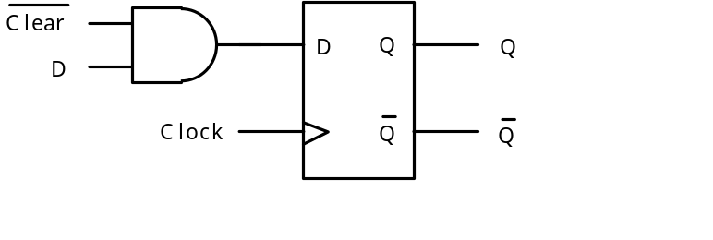
D Flip-Flop with Synchronous Clear
D
CLK
CLEAR
Q
(asynchronous clear)
Q
(synchronous clear)
Asynchronous active-low clear: Q immediately clears to 0
Synchronous active-low clear: Q clears to 0 on rising-edge of clock
DEU CSE
Şerife SUNGUN

Slide 6
Other Types of Flip-Flops
D Flip-Flop
Set-Reset (SR) Flip-Flop
D
Q
D | Q(t+1)
0 | 0
1 | 1
S
Q
S | R | Q(t+1)
0 | 0 | Q(t)
0 | 1 | 0
1 | 0 | 1
1 | 1 | not allowed
CLK
CLK
R
Toggle (T) Flip-Flop
JK Flip-Flop
T
Q
T | Q(t+1)
0 | Q(t)
1 | Q(t)
J
Q
J | K | Q(t+1)
0 | 0 | Q(t)
0 | 1 | 0
1 | 0 | 1
1 | 1 | Q(t)
CLK
CLK
K
DEU CSE
Şerife SUNGUN

Slide 7
Register
D(3)
D
Q
Q(3)
CLK
D(2)
D
Q
Q(2)
CLK
D(1)
D
Q
Q(1)
CLK
D(0)
D
Q
Q(0)
CLK
In typical nomenclature, a register is a name for a collection of flip-flops used to hold a bus.
DEU CSE
Şerife SUNGUN

Slide 8
Shift Register
Q
Q
Q
Q
In
D
Q
1
D
Q
2
D
Q
3
D
Q
4
Out
Clock
Q
Q
Q
Q
(a) Circuit
In
Q
Q
Q
Q
=
Out
1
2
3
4
t
1
0
0
0
0
0
t
0
1
0
0
0
1
t
1
0
1
0
0
2
t
1
1
0
1
0
3
t
1
1
1
0
1
4
t
0
1
1
1
0
5
t
0
0
1
1
1
6
t
0
0
0
1
1
7
(b) A sample sequence
DEU CSE
Şerife SUNGUN

Slide 9
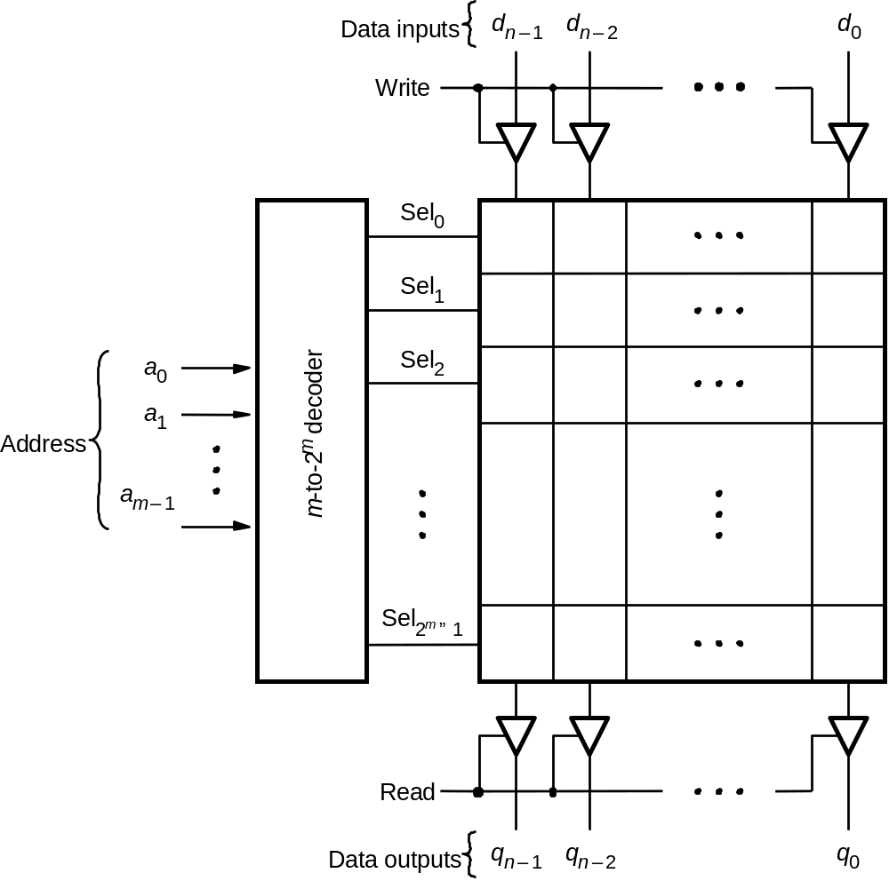
Random Access Memory (RAM)
DEU CSE
Şerife SUNGUN

Slide 10
Read Only Memory (ROM)
Similar to RAM except read only
Addressable memory
Can be synchronous (with clock) or asynchronous (no clock)
data in (n)
ROM
data out (n)
address (m)
read
DEU CSE
Şerife SUNGUN

Slide 11
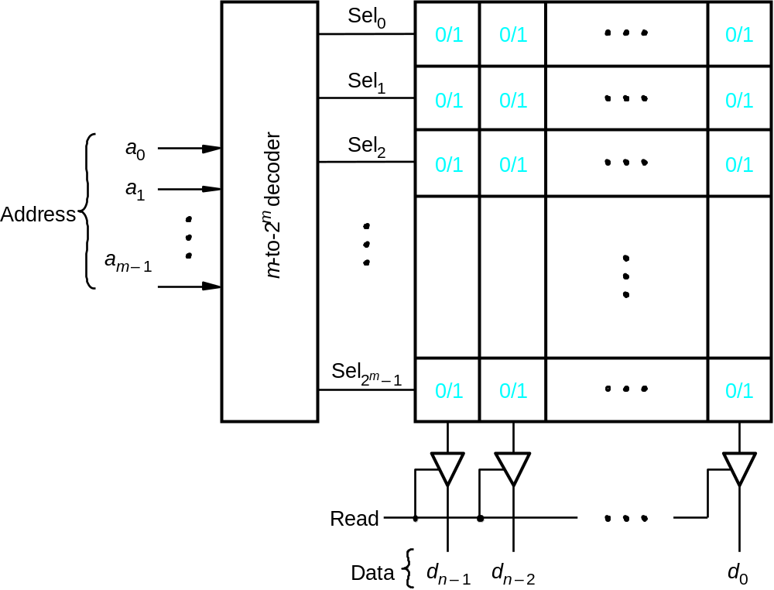
Read-Only Memory (ROM)
DEU CSE
Şerife SUNGUN

Slide 12
Finite State Machines (FSMs)
Any Circuit with Memory Is a Finite State Machine
  Even computers can be viewed as huge FSMs
Design of FSMs Involves
  Defining states
  Defining transitions between states
  Optimization / minimization
Above Approach Is Practical for Simple FSMs Only
DEU CSE
Şerife SUNGUN

Slide 13
Mealy vs. Moore State Machines
Finite State Machines (FSM) are of two types:
Moore Machines
  Next State = Function(Input, Present State)
  Output = Function(Present State)
Mealy Machines
  Next State = Function(Input, Present State)
  Output = Function(Input, Present State)
DEU CSE
Şerife SUNGUN

Slide 14
Moore FSM
Output Is a Function of a Present State Only
Inputs
Next State
Function
(comb. logic)
Next State
Present State
clock
Present State
Register
reset
Output
Function
(comb. logic)
Outputs
DEU CSE
Şerife SUNGUN

Slide 15
Mealy FSM
Output Is a Function of a Present State and Inputs
Inputs
Next State
Function
(comb. logic)
Next State
Present State
clock
Present State
Register
reset
Output
Function
(comb. logic)
Outputs
DEU CSE
Şerife SUNGUN

Slide 16
Moore Machine
transition
condition 1
state 1 /
output 1
state 2 /
output 2
transition
condition 2
DEU CSE
Şerife SUNGUN

Slide 17
Mealy Machine
transition condition 1 /
output 1
state 1
state 2
transition condition 2 /
output 2
DEU CSE
Şerife SUNGUN

Slide 18
Moore vs. Mealy FSM
Moore and Mealy FSMs can be functionally equivalent
  Equivalent Mealy FSM can be derived from Moore FSM and vice versa
Mealy FSM Has Richer Description and Usually Requires Smaller Number of States
  Smaller circuit area
DEU CSE
Şerife SUNGUN

Slide 19
Moore vs. Mealy FSM…
Mealy FSM computes outputs as soon as inputs change
  Mealy FSM responds one clock cycle sooner than equivalent Moore FSM
Moore FSM Has no combinational path between inputs and outputs
  Moore FSM is more likely to have a shorter critical path
  Moore outputs synchronized with clock; Mealy outputs may not be (may have race conditions, timing issues, etc.)
DEU CSE
Şerife SUNGUN

Slide 20
Example: Moore FSM
Moore FSM that Recognizes Sequence “10”
0
1
0
S0 / 0
1
S1 / 0
S2 / 1
1
reset
0
S0: No
elements
of the
sequence
observed
S1: “1”
observed
S2: “10”
observed
Meaning
of states:
DEU CSE
Şerife SUNGUN

Slide 21
Example: Mealy FSM
Mealy FSM that Recognizes Sequence “10”
0 / 0
1 / 0
1 / 0
S0
S1
reset
0 / 1
S0: No
elements
of the
sequence
observed
S1: “1”
observed
Meaning
of states:
DEU CSE
Şerife SUNGUN

Slide 22
Example:Moore & Mealy FSMs
clock
0 1 0 0 0
input
S0 S1 S2 S0 S0
Moore
S0 S1 S0 S0 S0
Mealy
DEU CSE
Şerife SUNGUN

Slide 23
FSM Limitations
Simple finite state machines (those expressed using state diagrams and state tables) good only for simple designs
  Many inputs and many outputs make it awkward to draw state machines
  Often only one input affects the next change of state
  Most outputs remain the same from state to state
Instead use algorithmic state machines (ASM)
DEU CSE
Şerife SUNGUN

Slide 24
Algorithmic State Machine (ASM)
Complex digital systems can be represented by algorithmic state machines
Simple finite state machines (expressed using state diagrams and state tables) good only for simple designs
Algorithmic State Machines (ASM) are
  flow-chart type diagrams to represent finite state machines
  suitable for a larger number of inputs and outputs compared to simple FSMs
DEU CSE
Şerife SUNGUN

Slide 25
Elements used in ASM charts
State name
Output signals
0 (False)
Condition
1 (True)
or actions
expression
(Moore type)
(a) State box
(b) Decision box
Conditional outputs
or actions (Mealy type)
(c) Conditional output box
DEU CSE
Şerife SUNGUN

Slide 26
State Box
State box – represents a state.
Equivalent to a node in a state diagram or a row in a state table.
Contains register transfer actions or output signals
Moore-type outputs are listed inside of the box.
It is customary to write only the name of the signal that has to be asserted in the given state, e.g., z instead of z=1.
Also, it might be useful to write an action to be taken, e.g., count = count + 1, and only later translate it to asserting a control signal that causes a given action to take place.
State name
Output signals
or actions
(Moore type)
DEU CSE
Şerife SUNGUN

Slide 27
Decision Box
Decision box – indicates that a given condition is to be tested and the exit path is to be chosen accordingly
The condition expression consists of one or more inputs to the FSM.
0 (False)
Condition
1 (True)
expression
DEU CSE
Şerife SUNGUN

Slide 28
Conditional Output Box
Conditional output box
Denotes output signals that are of the Mealy type.
The condition that determines whether such outputs are generated is specified in the decision box.
Conditional outputs
or actions (Mealy type)
DEU CSE
Şerife SUNGUN

Slide 29
ASMs representing simple FSMs
Algorithmic state machines can model both Mealy and Moore simple finite state machines
DEU CSE
Şerife SUNGUN

Slide 30
Example 1: Moore FSM –State diagram
Reset
w
=
1
w
=
0
A
⁄
z
=
0
B
⁄
z
=
0
w
=
0
w
=
0
w
=
1
C
⁄
z
=
1
w
=
1
DEU CSE
Şerife SUNGUN

Slide 31
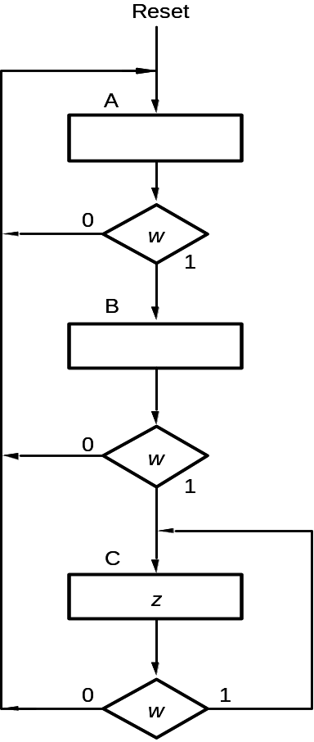
Example 1: ASM Chart for Moore FSM
DEU CSE
Şerife SUNGUN

Slide 32
Example 2: Mealy FSM –State diagram
Reset
w
=
1
⁄
z
=
0
w
=
0
⁄
z
=
0
A
B
w
=
1
⁄
z
=
1
w
=
0
⁄
z
=
0
DEU CSE
Şerife SUNGUN

Slide 33
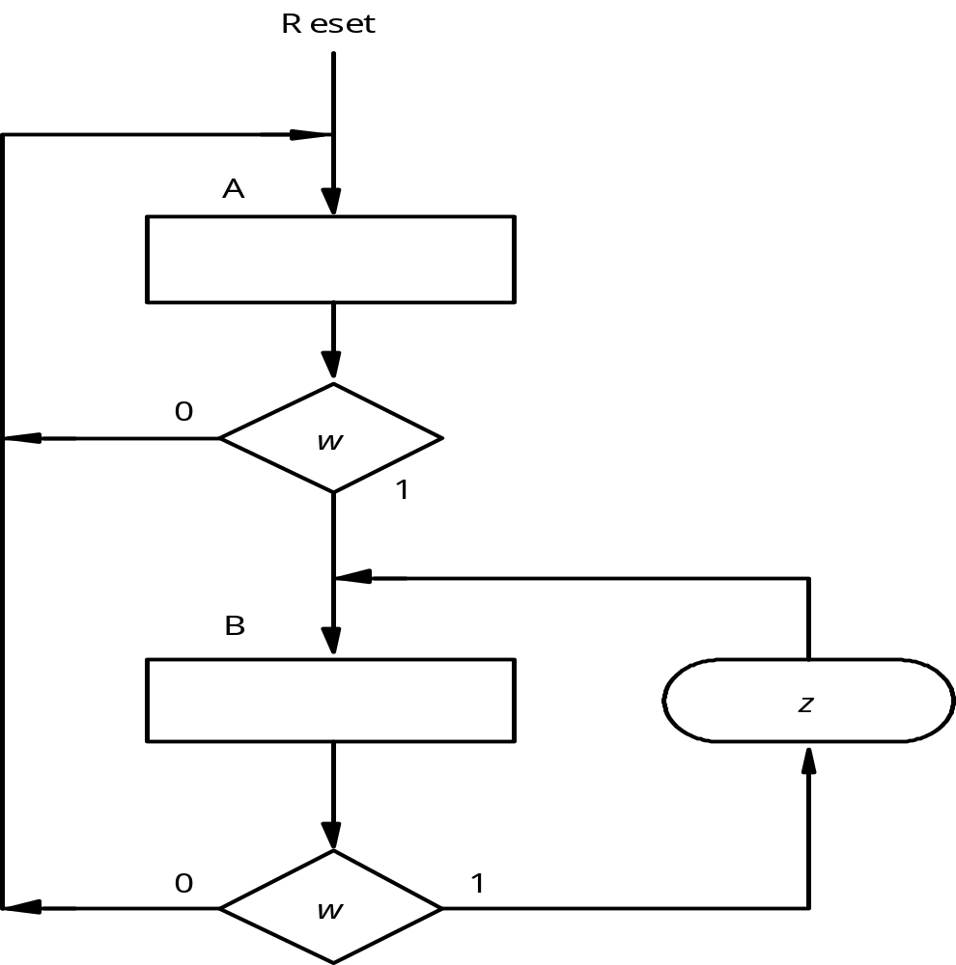
Example 2: ASM Chart for Mealy FSM
DEU CSE
Şerife SUNGUN

Slide 34
Example 3 – ASM Complex Counter Problem
A sync. 3 bit counter has a mode control M. When M = 0, the counter
counts up in the binary sequence. When M = 1, the counter advances
through the Gray code sequence.
Binary: 000, 001, 010, 011, 100, 101, 110, 111
Gray: 000, 001, 011, 010, 110, 111, 101, 100
Valid I/O behavior:
Mode Input M
0
0
1
1
1
0
0
Current State
000
001
010
110
111
101
110
Next State (Z2 Z1 Z0)
001
010
110
111
101
110
111
DEU CSE
Şerife SUNGUN

Slide 35
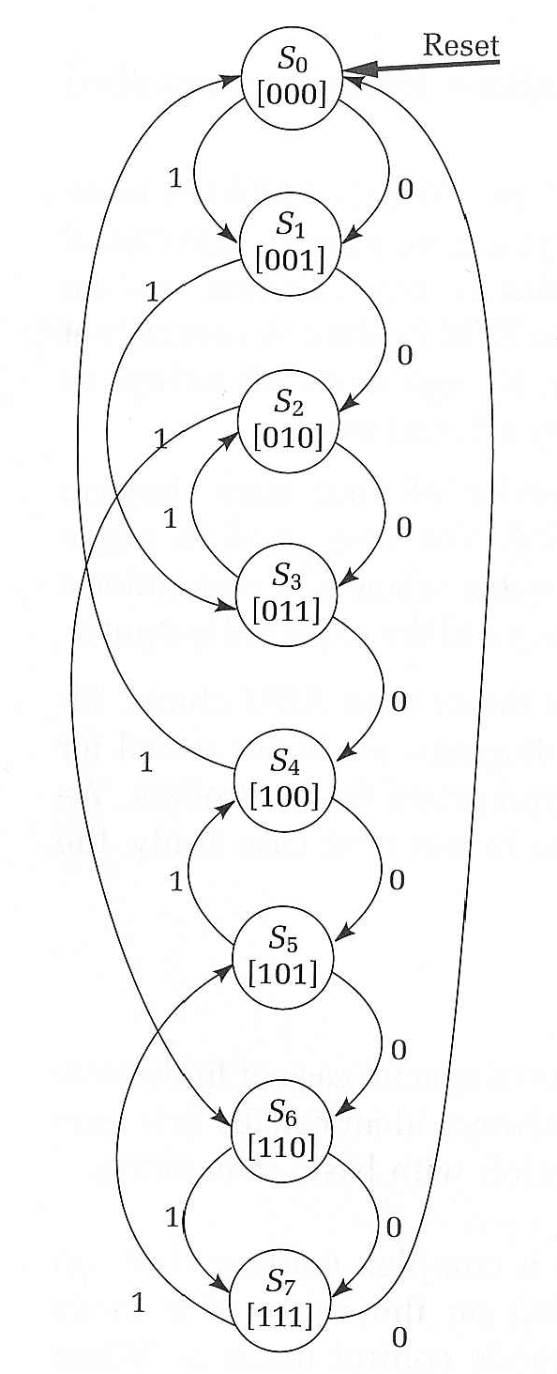
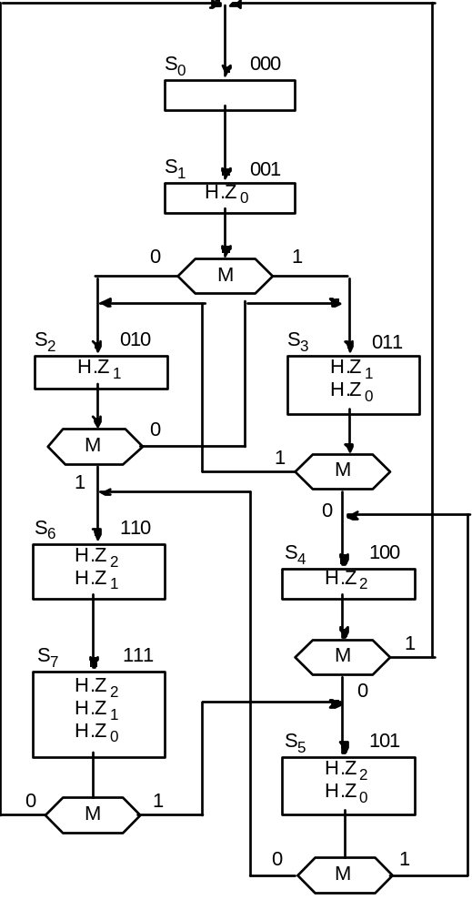
Example- Finite State Machine
One state for each output combination
Add appropriate arcs for the mode control
DEU CSE
Şerife SUNGUN

Slide 36
Example – State Diagram
State Diagram
State Table
0
0
A/0
1
B/0
Present State | Next State |  | Output (z)
 | Input (x)
 | 0 | 1
A | A | B | 0
B | B | C | 0
C | C | D | 1
D | D | A | 1
1
1
D/1
1
C/1
0
0
DEU CSE
Şerife SUNGUN

Slide 37
Example – State Table
State assignments:
00 → A
01 → B
10 → C
11 → D
Input | Present State |  | Next State |  | Output (z)
x | Q₁ | Q₂ | Q⁺₁ | Q⁺₂
0 | 0 | 0 | 0 | 0 | 0
0 | 0 | 1 | 0 | 1 | 0
0 | 1 | 0 | 1 | 0 | 1
0 | 1 | 1 | 1 | 1 | 1
1 | 0 | 0 | 0 | 1 | 0
1 | 0 | 1 | 1 | 0 | 0
1 | 1 | 0 | 1 | 1 | 1
1 | 1 | 1 | 0 | 0 | 1
DEU CSE
Şerife SUNGUN

Slide 38
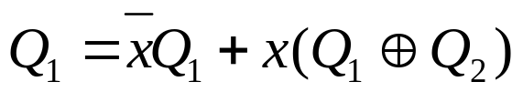
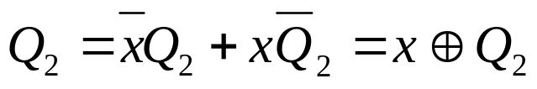

Example – Karnaough Map
Q₁ Q₂
Q₁ Q₂
x
00
01
11
10
x
00
01
11
10
0
0
0
1
1
0
0
1
1
0
1
0
1
0
1
1
1
0
0
1
Q₁ Q₂
x
00
01
11
10
0
0
1
1
0
1
0
1
1
0
DEU CSE
Şerife SUNGUN

Slide 39
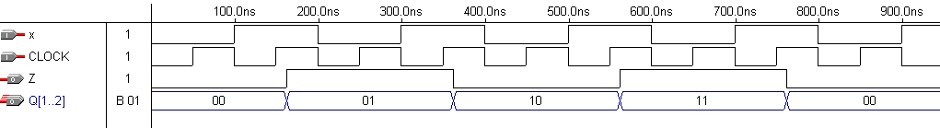
Circuit Implementation
x
Q1
Q1
X
CLOCK
D
PRN
Q
Q1
Q2
CLRN
x
x
Q2
CLOCK
D
PRN
Q
Q2
CLOCK
CLRN
Q2
Z
Wave Form
DEU CSE
Şerife SUNGUN

